Slide 1
NAME : MAIRAJ E MUSTAFA
FATHER NAME : JAVED ALI
CASTE : SAMOON
PHONE NO : 03481342814
PROJECT : PAKISTAN POPULATION
TRAINER : SIR MUHAMMAD ALI

Slide 2
DATASET INFORMATION
DATA ROW=528
Data columns = 21 columns
SIZE=11616
TOTAL DUPLICATE ROWS=0
TOTAL DUPLICATE COLUMNS=0
MEMORY USAGE= 86.8+ KB

Slide 3
DATA TYPE
PROVINCE object
DIVISION object
DISTRICT object
SUB DIVISION object
AREA (sq.km) float64
ALL SEXES (RURAL) int64
MALE (RURAL) int64
FEMALE (RURAL) int64
TRANSGENDER (RURAL) int64
SEX RATIO (RURAL) float64
AVG HOUSEHOLD SIZE (RURAL) float64
POPULATION 1998 (RURAL) int64
ANNUAL GROWTH RATE (RURAL) float64
ALL SEXES (URBAN) int64
MALE (URBAN) int64
FEMALE (URBAN) int64
TRANSGENDER (URBAN) int64
SEX RATIO (URBAN) float64
AVG HOUSEHOLD SIZE (URBAN) float64
POPULATION 1998 (URBAN) int64
ANNUAL GROWTH RATE (URBAN) float64

Slide 4
COLUMNS
PROVINCE
DIVISION
DISTRICT
SUB DIVISION
AREA (sq.km)
ALL SEXES (RURAL)
MALE (RURAL)
FEMALE (RURAL)
TRANSGENDER (RURAL)
SEX RATIO (RURAL)
AVG HOUSEHOLD SIZE (RURAL)
POPULATION 1998 (RURAL)
ANNUAL GROWTH RATE (RURAL)
ALL SEXES (URBAN)
MALE (URBAN)
FEMALE (URBAN)
TRANSGENDER (URBAN)
SEX RATIO (URBAN)‘
AVG HOUSEHOLD SIZE (URBAN)
POPULATION 1998 (URBAN)
ANNUAL GROWTH RATE (URBAN'

Slide 5
NULL VALUE
PROVINCE 0
DIVISION 0
DISTRICT 0
SUB DIVISION 0
AREA (sq.km) 0
ALL SEXES (RURAL) 0
MALE (RURAL) 0
FEMALE (RURAL) 0
TRANSGENDER (RURAL) 0
SEX RATIO (RURAL) 0
AVG HOUSEHOLD SIZE (RURAL) 0
POPULATION 1998 (RURAL) 0
ANNUAL GROWTH RATE (RURAL) 0
ALL SEXES (URBAN) 0
MALE (URBAN) 0
FEMALE (URBAN) 0
TRANSGENDER (URBAN) 0
SEX RATIO (URBAN) 0
AVG HOUSEHOLD SIZE (URBAN) 0
POPULATION 1998 (URBAN) 0
ANNUAL GROWTH RATE (URBAN) 0

Slide 6
PAKISTAN
DIVISIONS , DISTRICTS, SUB DIVISIONS
DIVISIONS | DISTRICTS | SUB DIVISIONS
28 | 131 | 528

Slide 7
Name of all Provinces
THERE IS A FIVE PROVINCE OF PAKISTAN
PUNJAB
SINDH
BALOCHISTAN
KPK
KPK/FATA

Slide 8
PROVINCE | DIVISIONS | DISTRICTS | SUB DIVISIONS
SINDH | 7 | 29 | 137
PUNJAB | 9 | 36 | 143
KPK | 7 | 23 | 71
KPK / FATA region | 5 | 12 | 46
BALOCHISTAN | 5 | 31 | 131

Slide 9
LARGEST POPULATION IN PAKISTAN
CATEGORY | NAME | POPULATION
DIVISION | LAHORE DIVISION | 19389856
DISTRICT | LAHORE DISTRICT | 11119985
SUB DIVISION | PESHAWAR TEHSIL | 4267198

Slide 10
LARGEST AREA OF PAKISTAN
CATEGORY | NAME | AREA
DIVISION | Makran Division | 143591
DISTRICT | CHAGAI DISTRICT | 44748
SUB DIVISION | YAZMAN TEHSIL | 18374

Slide 11
COMPREHENSIVE POPULATION SUMMARY
PAKISTAN COUNTRY OVERVIEW
Total Population: 204,410,733
Total Area: 787,779 sq.km
Population Density: 259.48 people/sq.km

Slide 12
PROVINCE-WISE BREAKDOWN
BALOCHISTAN
Population: 12,286,335
Area: 345,464 sq.km
Density: 35.56 people/sq.km
Urban: 27.7%
Rural: 72.3%
Sex Ratio: 90.3 (females per 100 males)

Slide 13
KPK
Population: 30,497,911
Area: 74,957 sq.km
Density: 406.87 people/sq.km
Urban: 18.4%
Rural: 81.6%
Sex Ratio: 97.8 (females per 100 males)

Slide 14
KPK/FATA
Population: 4,727,619
Area: 24,529 sq.km
Density: 192.74 people/sq.km
Urban: 3.0%
Rural: 97.0%
Sex Ratio: 95.5 (females per 100 males)

Slide 15
PUNJAB
Population: 109,054,593
Area: 202,693 sq.km
Density: 538.03 people/sq.km
Urban: 37.0%
Rural: 63.0%
Sex Ratio: 96.7 (females per 100 males)

Slide 16
SINDH
Population: 47,844,275
Area: 140,136 sq.km
Density: 341.41 people/sq.km
Urban: 51.9%
Rural: 48.1%
Sex Ratio: 92.3 (females per 100 males)

Slide 17
Divisions exist within Pakistan
There are 28 divisions in Pakistan
BAHAWALPUR DIVISION
D.G.KHAN DIVISION
FAISALABAD DIVISION
GUJRANWALA DIVISION
LAHORE DIVISION
MULTAN DIVISION
RAWALPINDI DIVISION
SAHIWAL DIVISION
SARGODHA DIVISION
Badin Division
Hyderabad Division
Karachi Division
Larkana Division
Mirpurkhas Division
Shaheed Benazirabad Division
Sukkur Division
Makran Division
Kalat Division
Naseerabad Division
Quetta Division
Zhob Division‘
BANNU DIVISION
DERA ISMAIL KHAN DIVISION
HAZARA DIVISION
KOHAT DIVISION
MARDAN DIVISION
PESHAWAR DIVISION
MALAKAND DIVISION

Slide 18
The Total Number Of Districts In Pakistan
There are 131 districts in Pakistan
Sub-divisions are there in Pakistan
There are 528 sub-divisions in Pakistan

Slide 19
Number of Divisions in each Province
PROVINCE DIVISIONS
BALOCHISTAN 5
KPK 7
KPK/FATA 5
PUNJAB 9
SINDH 7

Slide 20
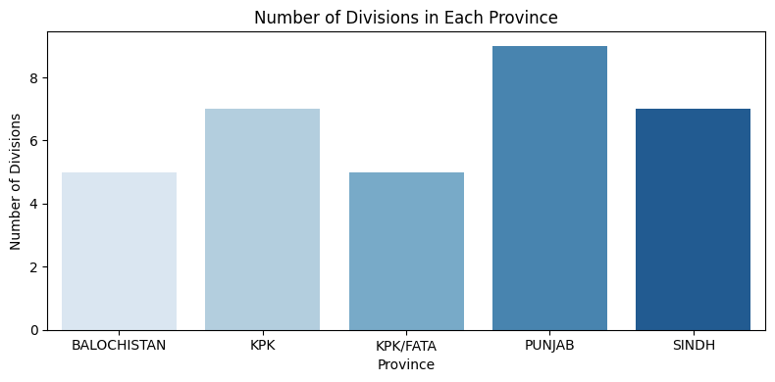

Slide 21
Number of Districts in each Province
PROVINCE DISTRICTS
BALOCHISTAN 31
KPK 23
KPK/FATA 12
PUNJAB 36
SINDH 29

Slide 22
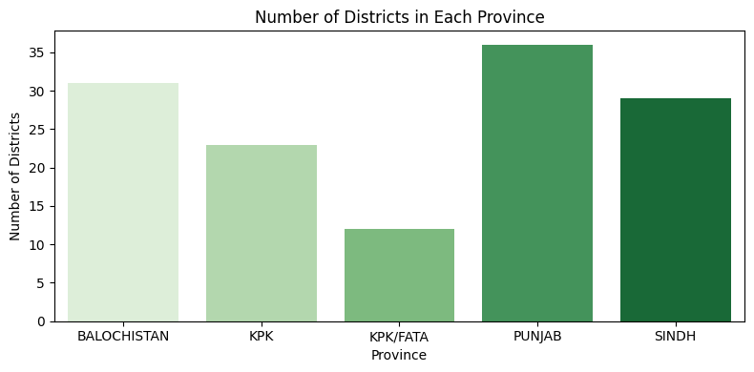

Slide 23
Number of Sub-divisions in each Province
PROVINCE SUB-DIVISIONS
BALOCHISTAN 131
KPK 71
KPK/FATA 46
PUNJAB 143
SINDH 137

Slide 24
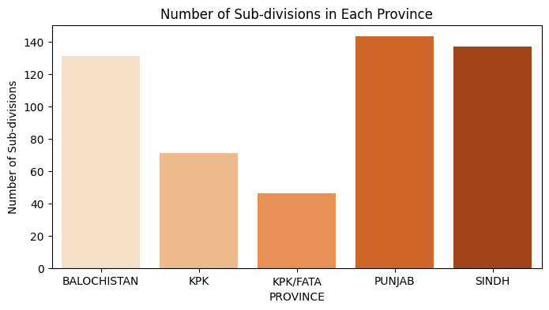

Slide 25
The Number of Administrative Units in each Province is as follows:
PUNJAB: 9 Divisions 36 Districts, 143 Sub-Divisions
SINDH: 7 Divisions, 29 Districts, 137 Sub-Divisions
KPK: 7 Divisions, 23 Districts, 71 Sub-Divisions
BALOCHISTAN: 5 Divisions, 31 Districts, 131 Sub-Divisions
KPK/FATA: 5 Divisions, 12 District, 46 Sub-Divisions

Slide 26
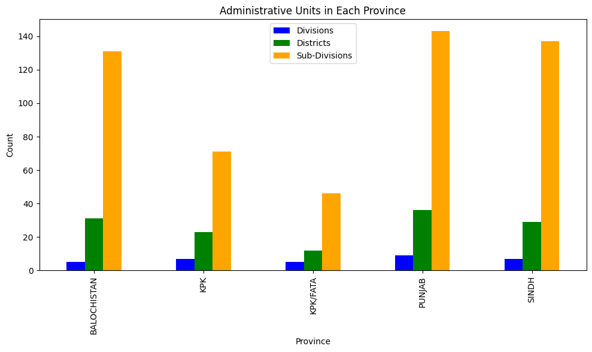

Slide 27
Province covers area(sq.km) in Pakistan
TOTAL AREA OF PAKISTAN=787779.1
BALOCHISTAN 345464.0
PUNJAB 202693.0
SINDH 140136.0
KPK 74957.1
KPK/FATA 24529.0

Slide 28
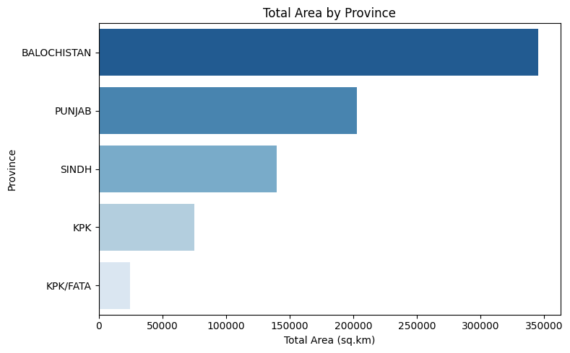

Slide 29
SMALLEST VS LARGEST AREA
Province covers the largest area in Pakistan
Balochistan covers the largest area in Pakistan, with a total area of 345,464 square kilometers
Province has the smallest area
KPK/FATA has the smallest area in Pakistan, with a total area of 24,529 square kilometers

Slide 30
Total Population of each Province
TOTAL POPULATION OF PAK= 204410733
PROVINCE POPULATION
PUNJAB 109054593
SINDH 47844275
KPK 30497911
BALOCHISTAN 12286335
KPK/FATA 4727619

Slide 31
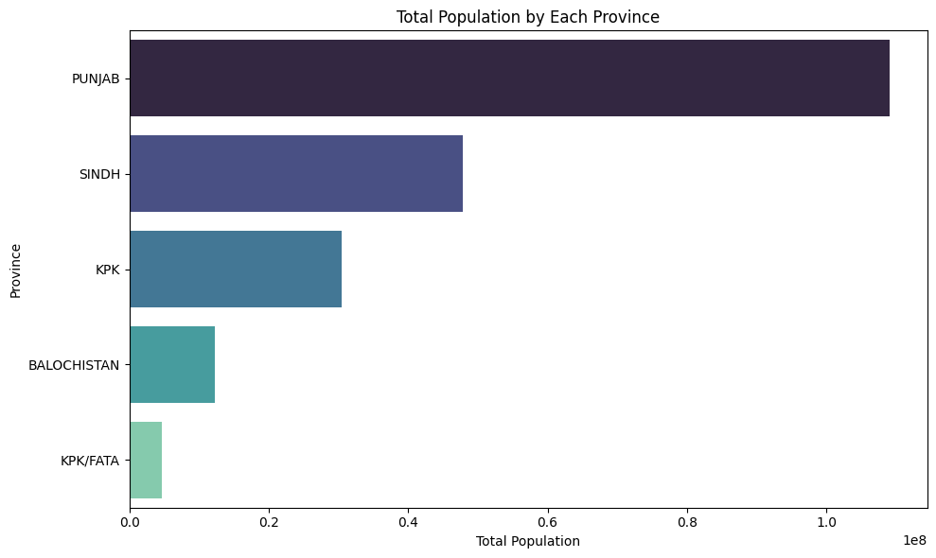

Slide 32
The Total Population of Pakistan (2017) (including both rural and urban areas)
Total Population of Pakistan (2017): 204410733
DIVISION POPULATION
LAHORE DIVISION 19389856
GUJRANWALA DIVISION 16120861
Karachi Division 16024894
FAISALABAD DIVISION 14185231
MULTAN DIVISION 12268173
BAHAWALPUR DIVISION 11452594
D.G.KHAN DIVISION 10426847
RAWALPINDI DIVISION 10006624
MALAKAND DIVISION 9321400
Hyderabad Division 8780856
PESHAWAR DIVISION 8193690
SARGODHA DIVISION 7826342
SAHIWAL DIVISION 7378065
Larkana Division 6190926
Sukkur Division 5542270
HAZARA DIVISION 5323155
Shaheed Benazirabad Division 5275426
Quetta Division 5097730
Mirpurkhas Division 4224945
MARDAN DIVISION 3998876
KOHAT DIVISION 2976107
DERA ISMAIL KHAN DIVISION 2759435
BANNU DIVISION 2652867
Makran Division 2508969
Badin Division 1804958
Naseerabad Division 1661077
Zhob Division 1541929
Kalat Division 1476630

Slide 33
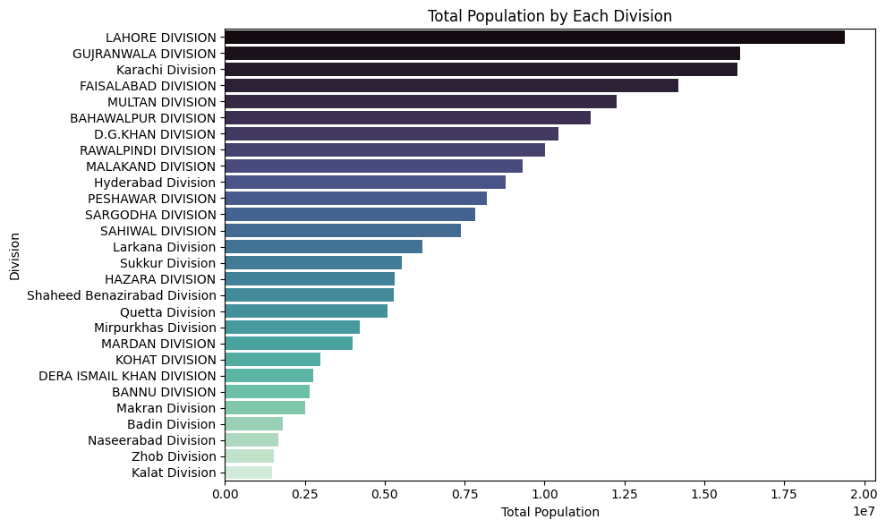

Slide 34
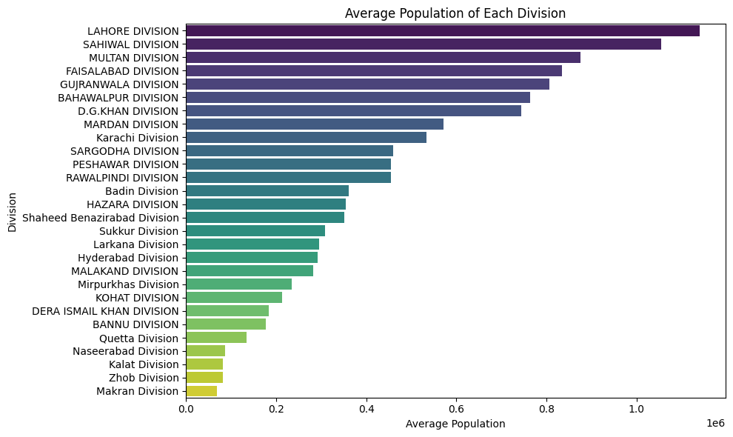

Slide 35
SMALLEST VS LARGEST POPULATION
Punjab Divison has the largest population (i.e Lahore Division with 19389856 peoples)

Slide 36
Gender Distribution (male/female) in Each Province
PROVINCE MALE (RURAL) MALE (URBAN) FEMALE (RURAL) FEMALE(URBAN)
BALOCHISTAN 4658709 1797980 4220436 1608430
KPK 12524211 2897645 12367532 2706563
KPK/FATA 2344159 73438 2243307 66406
PUNJAB 34695963 20743951 33961383 19640941
SINDH 11922521 12948294 11086973 11880533
PROVINCE TOTAL MALE TOTAL FEMALE
BALOCHISTAN 6456689 5828866
KPK 15421856 15074095
KPK/FATA 2417597 2309713
PUNJAB 55439914 53602324
SINDH 24870815 22967506

Slide 37
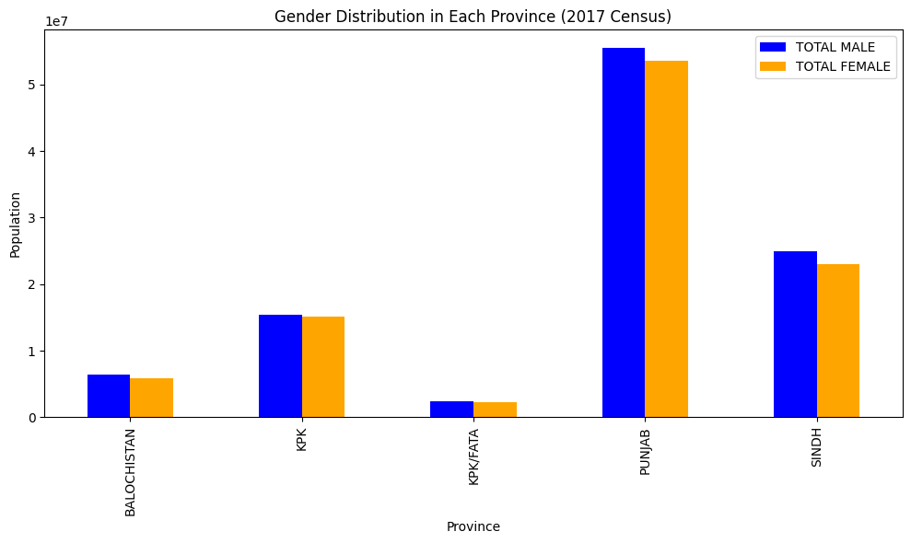

Slide 38
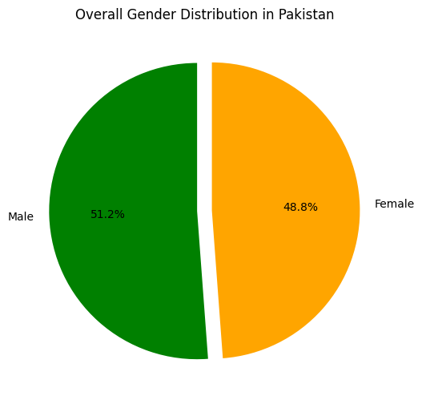

Slide 39
Province is the Rural Population of all Genders the Highest
PUNJAB the rural population of all Gender is high which is 68657346
PROVINCE ALL SEX(RURAL)
PUNJAB 68662922
KPK 24892840
SINDH 23011641
BALOCHISTAN 8879634
KPK/FATA 4587753

Slide 40
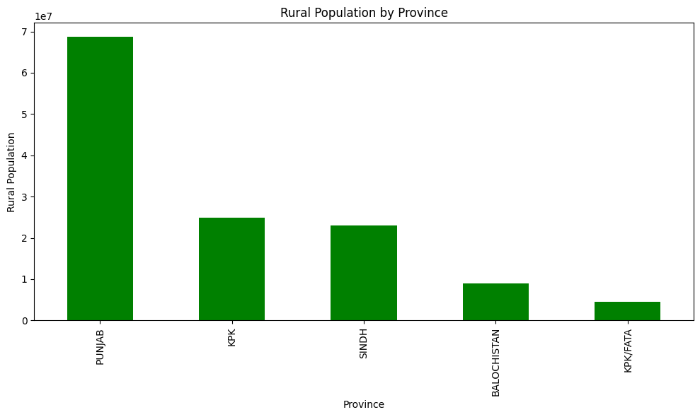

Slide 41
Urban vs. Rural population in each province:
PROVINCE ALL SEXES (URBAN) ALL SEXES (RURAL)
BALOCHISTAN 3406701 8879634
KPK 5605071 24892840
KPK/FATA 139866 4587753
PUNJAB 40391671 68662922
SINDH 24832634 23011641

Slide 42
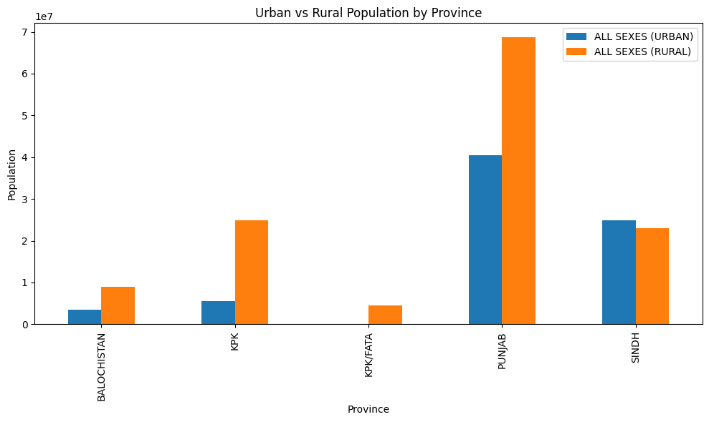

Slide 43
The overall sex ratio in each (Female per 1000 males) province is as follows:
PROVINCE SEX RATIO
PUNJAB: 966.85
KPK: 977.45
KPK/FATA: 955.38
BALOCHISTAN: 902.76
SINDH: 923.47

Slide 44
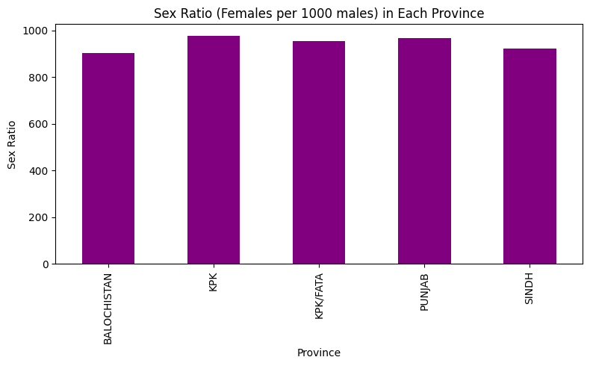

Slide 45
The Sex Ratio differ in Urban and Rural areas
The sex ratio (females per 1000 males) is higher in rural areas compared to urban areas for all provinces. For example, in Punjab, the rural sex ratio is 978.83 while the urban is 946.83; in KPK, rural is 987.49 and urban is 934.06.
PROVINCE SEX RATIO URBAN SEX RATIO RURAL
BALOCHISTAN 894.576135 905.923937
KPK 934.056104 987.489911
KPK/FATA 904.245758 956.977321
PUNJAB 946.827391 978.828084
SINDH 917.536550 929.918513

Slide 46
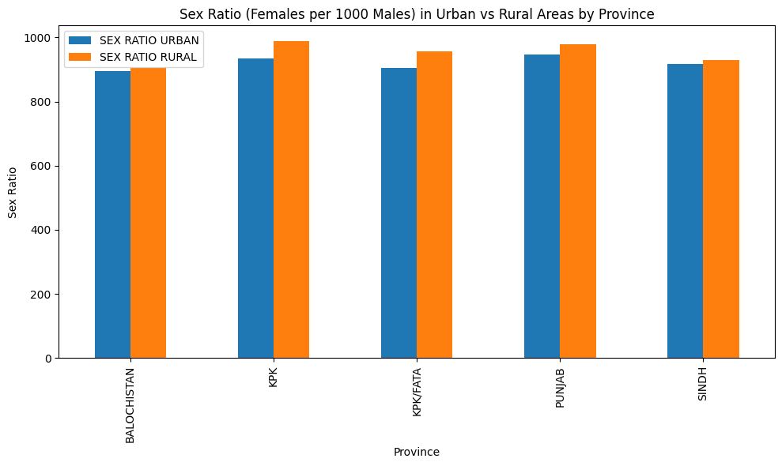

Slide 47
Average Household Size in Each Province (both by Rural and Urban)
The average household size in each province (by Rural and Urban areas) is:
PUNJAB: Rural 6.15, Urban 6.12
SINDH: Rural 4.36, Urban 5.28
KPK: Rural 8.09, Urban 4.30
BALOCHISTAN: Rural 6.60, Urban 2.92
KPK/FATA: Rural 8.68, Urban 0.86

Slide 48
The average household size differ between rural and urban areas?
Difference in Average Household Size (Rural - Urban)
PROVINCE AVERAGE HOUSEHOLD
BALOCHISTAN 3.680763
KPK 3.791549
KPK/FATA 7.821739
PUNJAB 0.019441
SINDH -0.921533

Slide 49
The growth rate of the population in each province from 1998 to 2017
Population Growth Rate from 1998 to 2017 by Province:
PROVINCE GROWTH RATE
BALOCHISTAN 87.878727
KPK 71.564171
KPK/FATA 59.302510
PUNJAB 49.380060
SINDH 57.227651

Slide 50
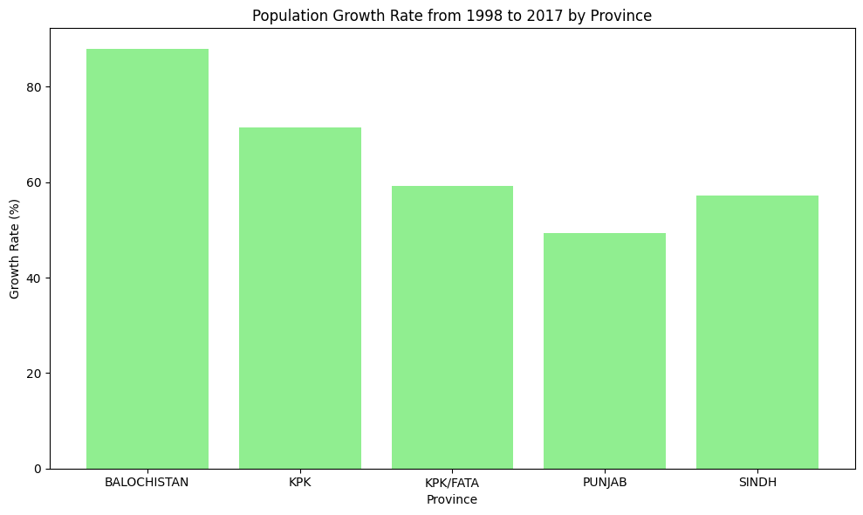

Slide 51
SUMMARY
Summary of the Analysis
In this analysis I take a look at Pakistan's population and administrative setup using the 2017 census data. Here are the key findings from the analysis:
Administrative Units
Provinces: There are five main provinces/regions: Punjab, Sindh, KPK, Balochistan, and KPK/FATA.
Divisions: Punjab has the most divisions (9), Sindh and KPK have 7 each, Balochistan has 5, and KPK/FATA also has 5.
Districts: Punjab has 36 districts, Balochistan 31, Sindh 29, KPK 23, and KPK/FATA 12.
Sub-divisions: Punjab leads with 143, Sindh has 137, Balochistan 131, KPK 71, and KPK/FATA 46.

Slide 52
TOTAL POPULATION 2017
  Punjab: 109,054,593
  Sindh: 47,844,275
  KPK: 30,497,911
  Balochistan: 12,286,335
  KPK/FATA: 4,727,619

Slide 53
Largest Division: Lahore Division in Punjab has the biggest population: 19,389,856.
Urban vs Rural: Punjab and Sindh have a lot of people living in cities, but in most provinces, more people live in villages except Sindh, where it’s almost equal.
Rural Population: Punjab has the highest rural population (68,662,922), then KPK (24,892,840), and Sindh (23,011,641).

Slide 54
Gender Distribution & Sex Ratio
Overall: There are a bit more males than females in every province. For example, in Balochistan, the male/female ratio is about 1.11, and in KPK, it’s about 1.02.
Sex Ratio (Females per 1000 Males): Highest in KPK (977), lowest in Balochistan (903).
Urban vs Rural: Usually, the sex ratio is higher in rural areas than in cities.
Household Size
Average Household Size: People in villages usually live in bigger families. KPK and KPK/FATA have the biggest rural household sizes (8.09 and 8.68).

Slide 55
AREA
Largest Province by Area: Balochistan is the biggest (345,464 sq.km).
Smallest by Area: KPK/FATA is the smallest (24,529 sq.km).
Population Growth
Growth Rate (1998-2017):
  Balochistan: 87.88%
  KPK: 71.56%
  KPK/FATA: 59.30%
  Sindh: 57.23%
  Punjab: 49.38%

Slide 56
Key Takeaways
Punjab has the most people and the most districts/divisions.
Balochistan is huge in area but not many people live there compared to its size.
Sindh is the most urbanized (lots of people live in cities).
There are more males than females, especially in Balochistan.
Population is growing really fast in Balochistan and KPK.

Slide 57
THANK
YOU

